Slide 1
TABLEAU PORTFOLIO
Prepared by
SAJIDA SALAM

Slide 2
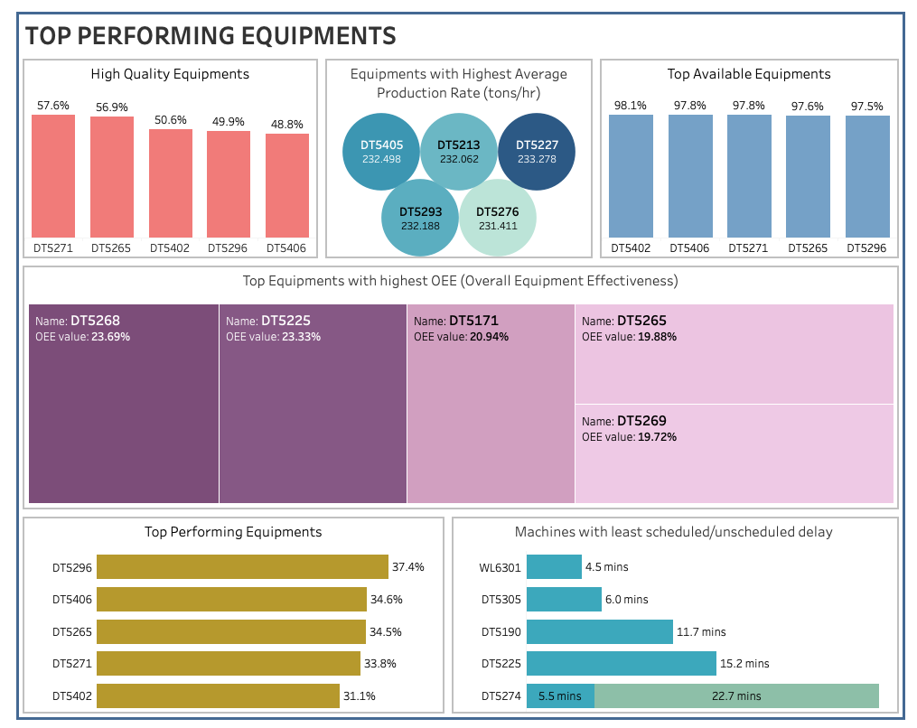
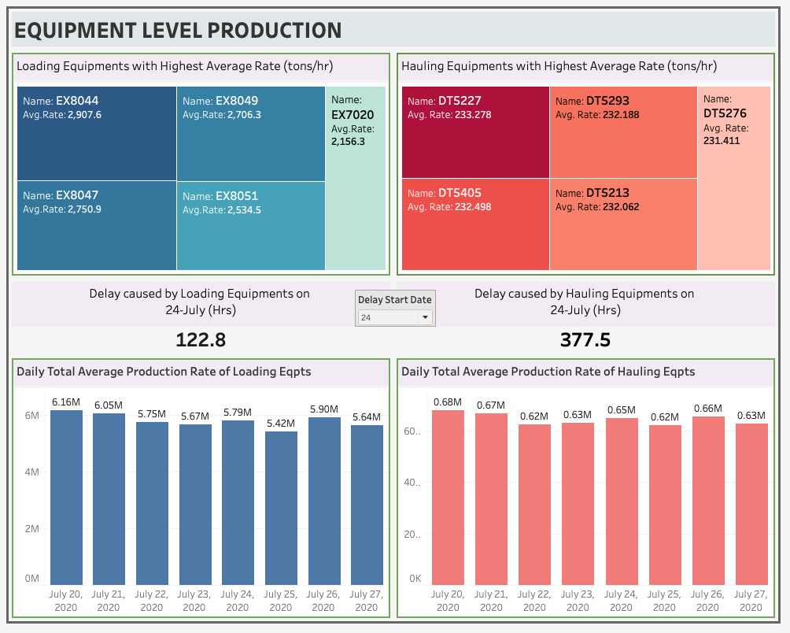
SUPPLY CHAIN ANALYSIS
(CAPSTONE PROJECT)
Build a smart live monitoring system using Tableau to understand the key metrics explained by the client and apply knowledge of supply chains to track inventory and quantity available and understand what is happening on the ground at each location.
The mine has operations such as the digging of ore and crushing of ore into a finer composition where this ore gets transported between the diggers and crushers using transportation trucks. The mine operators want to understand their tracking and operations on the field in detail.
Top equipments’ list based on:
- Quality
- Availability
- Average production rate
- Overall Equipment Effectiveness metrics
Equipment level production analysis on:
- Loading equipments with highest avg. rate
- Hauling equipments with highest avg. rate
- Loading eqpts with highest daily total avg. production rate
- Hauling eqpts with highest daily total avg. production rate

Slide 3
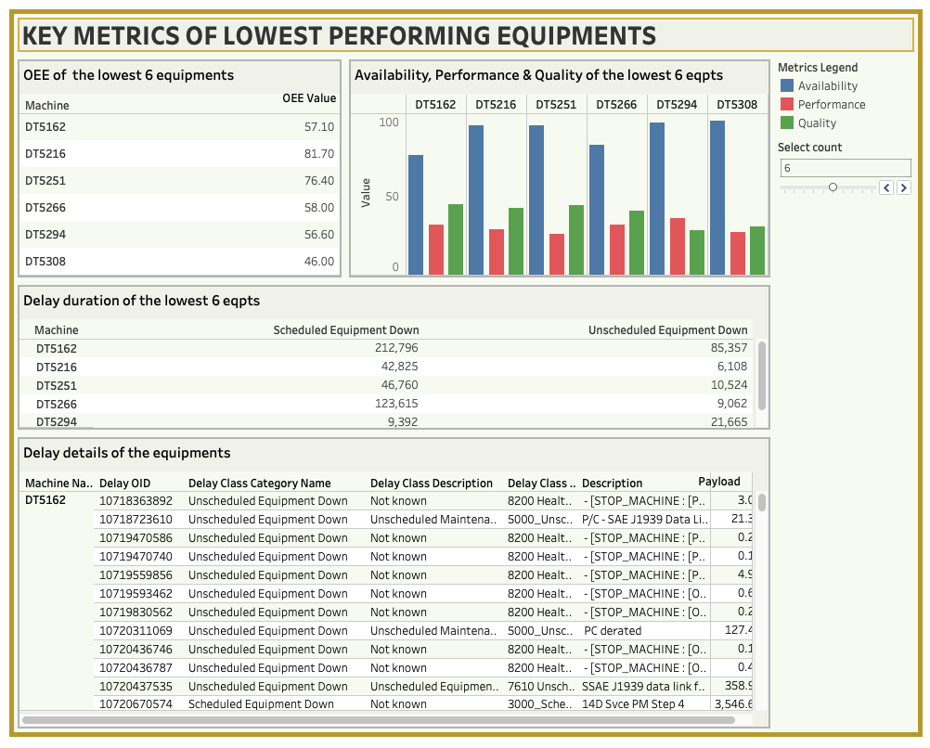
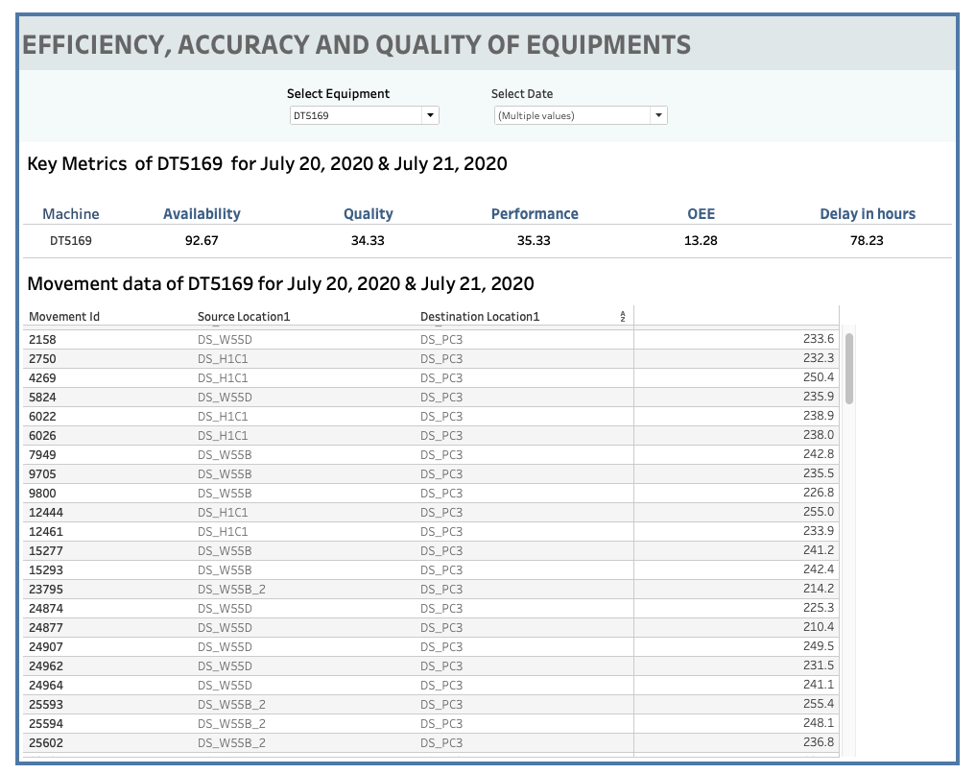
SUPPLY CHAIN ANALYSIS
(CAPSTONE PROJECT)
Analysis of lowest performing equipments based on :
- Overall equipment effectiveness
- Delay duration
Equipment-wise analysis on:
- Availability
- Quality
- Performance
- Delay duration
- OEE metrics
- Movement data filtered by date

Slide 4
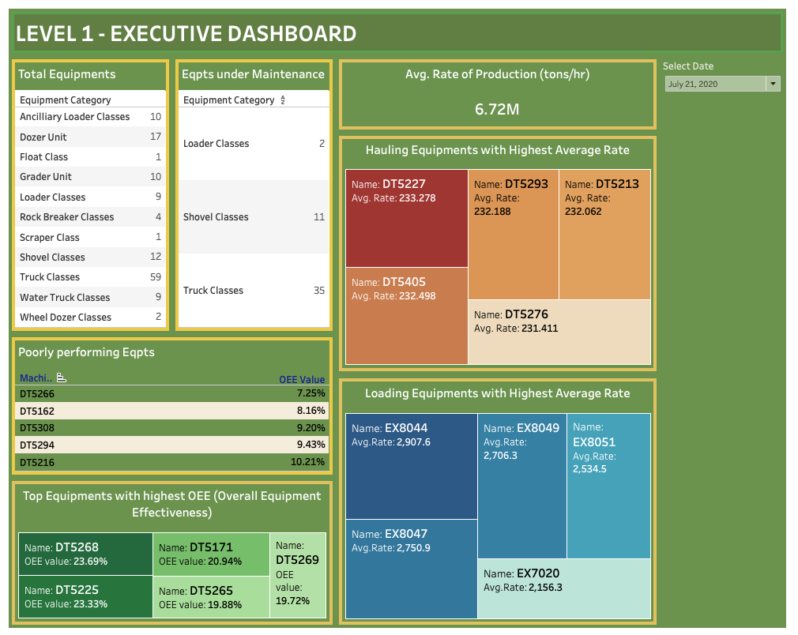
SUPPLY CHAIN ANALYSIS
(CAPSTONE PROJECT)
Executive Dashboard: Dashboard with all the details in one
- Count of equipments available on ground
- Count of equipments under maintenance
- Average production rate for the selected date
- Top/Poor performing equipments based on OEE
- Top loading/hauling equipments on highest average rate

Slide 5
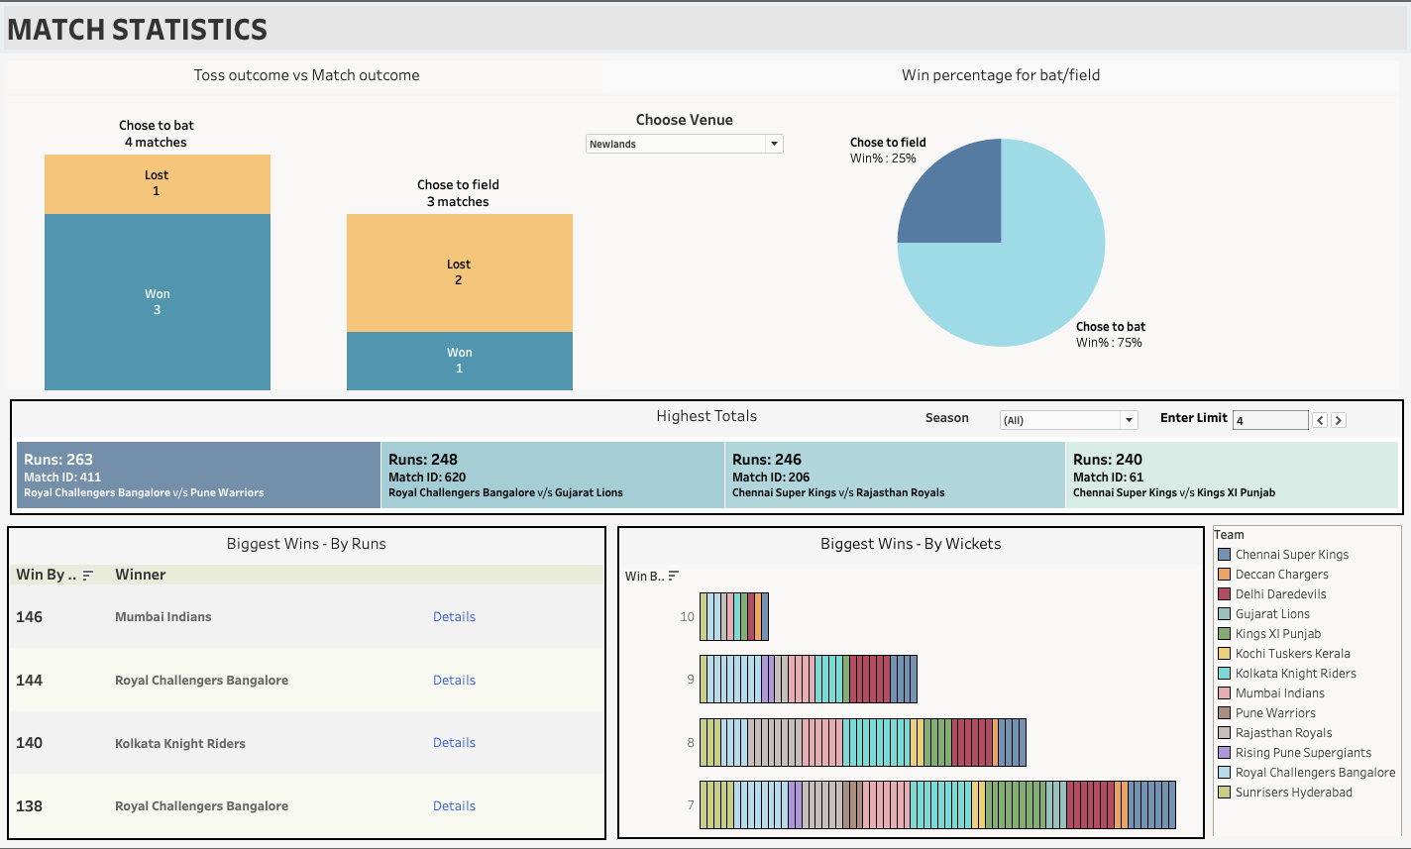
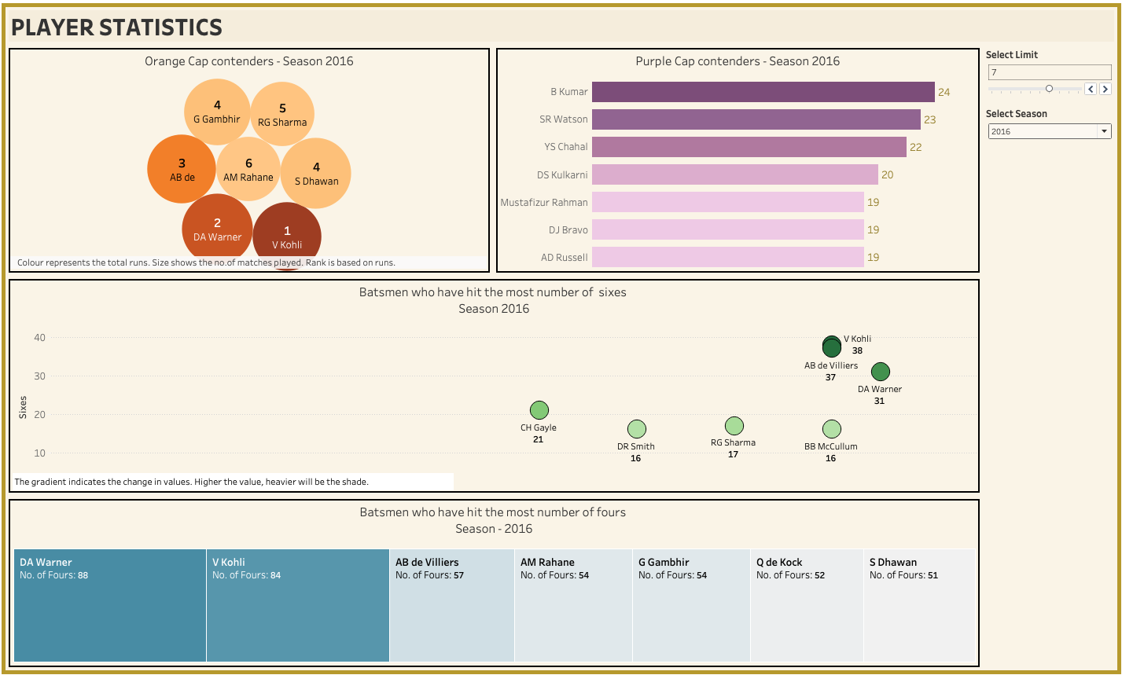
IPL STATISTICS
(2008 – 2017)
Build a Tableau dashboard for the Indian Premium League statistics over the years (2008-2017) since its inception to create an infographic for IFP, a nationally recognized news agency.
With match-level information and ball-by-ball information for seasons 2008 - 2017, it is expected to build an interactive that highlights some of the Match, Player and Team statistics of IPL over the seasons.
Analysis on Match was done for :
- Toss winner v/s. Match winner based on grounds
- Overall highest totals
- Biggest wins by number of wickets
- Biggest wins by runs for the period
Player Stats was taken for :
- Orange Cap contenders (max. runs in a season)
- Purple Cap contenders (max. wickets in a season)
- Maximum no. of 4’s and 6’s (all seasons)

Slide 6
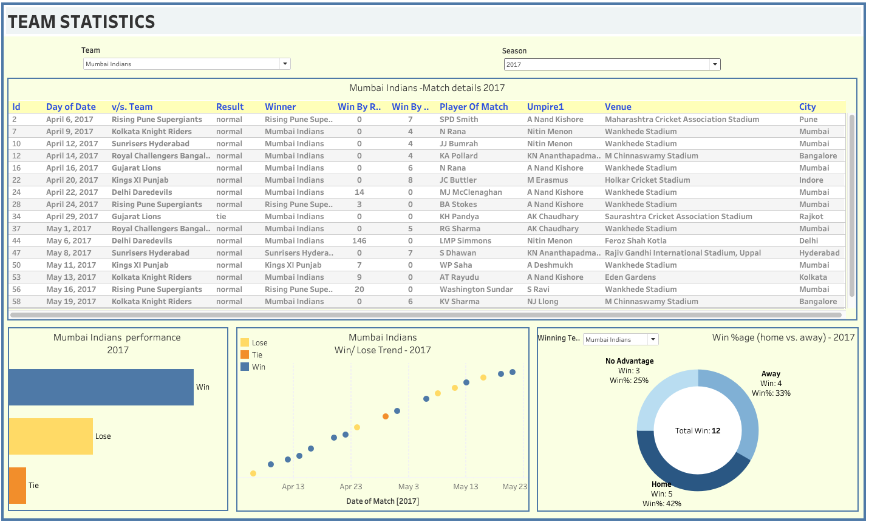
IPL STATISTICS
(2008 – 2017)
Team stats was taken for :
- Season-wise performance
- Details of matches of the team season-wise
- Season-wise win/lose trend
- Home/Away in percentage

